Slide 1

DATA CURATION AND MANAGEMENT GROUP 3 Presentation by
Mohammed Kamalidin
Regina Robertson
Clement Kwaku Boadu
John Abbiw Bonney

Slide 2
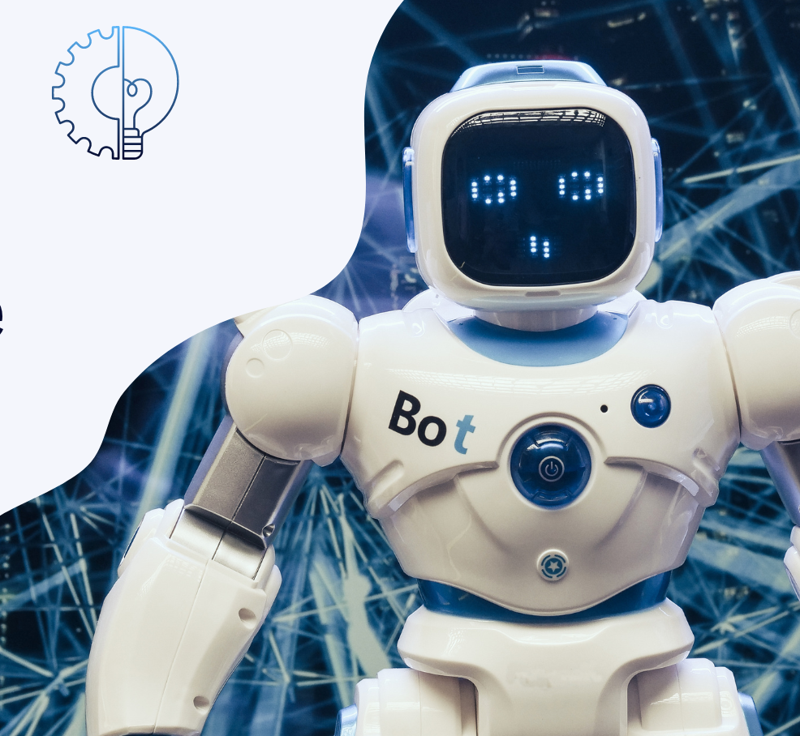
QUESTIONS
GROUP 3 PRESENTATION
Language Models (LMs) have transformed the world of unstructured data.
Present a brief history of LMs and demonstrate how their emerging abilities can revolutionise the field of data curation and management.

Slide 3
AGENDA
Introduction to LMs
Brief History of Language Models
Revolutionising Data Curation and Management through Emerging LMs Abilities
Future Potential & Ethical Consideration
Limitations of LMs
Impact of LMs on Data Curation & Management
Conclusion
References

Slide 4

INTRODUCTION TO LMs
OVERVIEW OF LANGUAGE MODELS
Language Models (LMs) are advanced artificial intelligence systems designed to process, understand and generate human language in both written and spoken forms. They function by learning statistical and semantic patterns from vast amounts of textual data, enabling them to interpret context, infer meaning and produce coherent responses or content.

Slide 5
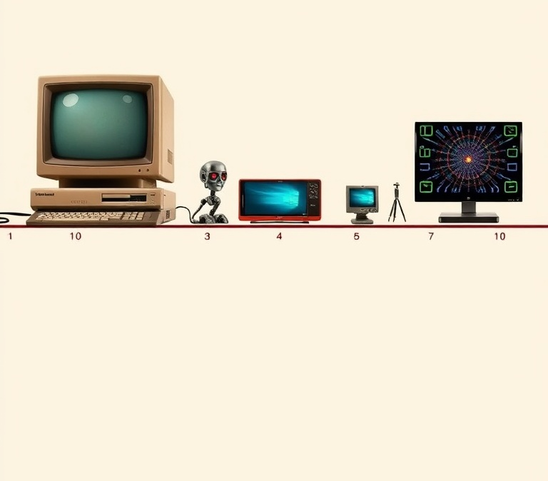
BRIEF HISTORY OF LANGUAGE MODELS
Cover the progression of Language Models (LMs) from early rule-based models to neural network LMs, then deep learning models and finally transformer-based architectures.

Slide 6
FOUR KEY STAGES
Grammar
rules
& n-gram models
Word embeddings
like
Word2Vec & GloVe
RNNs,
LSTMs, attention mechanisms
Self-attention, BERT,
GPT series, multimodal models.
Rule-Based & Statistical Models (1950s-1990s)
Neural Network LMs (2000-2014)
Deep Learning & Sequence Models (2015-2017)
Transformer Era (2018–Present)
Brief History on LMs
.

Slide 7
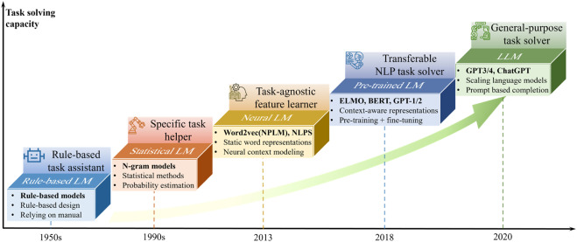
FOUR KEY STAGES CONT’D
Rule-Based & Statistical Models (1950s-1990s)
Early language models used strict, handcrafted grammar rules that ensured precision but lacked flexibility. By the late 1980s and 1990s, statistical methods like n-gram models emerged, allowing systems to learn word probabilities from large text datasets. This probabilistic shift illustrated by IBM’s statistical machine translation offered greater adaptability and set the foundation for today’s modern language models.

Slide 8
Example
N-Gram Language Modelling
An n-gram model predicts the next word based on the previous n–1 words. For example, a bigram model (n=2) trained on “The cat sat on the mat” extracts word pairs like “The cat” and “cat sat”, counts their frequencies and calculates probabilities (e.g., P(cat | The) = 1.0). Larger datasets and higher-order n-grams capture richer context, with smoothing used to handle unseen combinations. This probabilistic approach replaced rigid grammar rules, learning from real text usage.

Slide 9
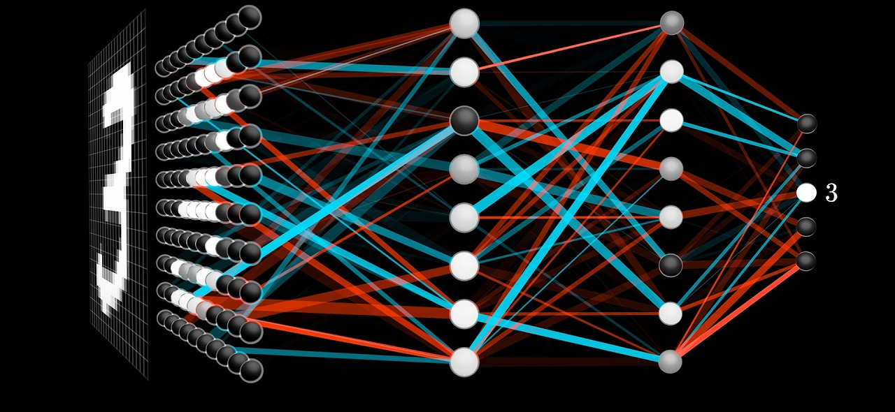
FOUR KEY STAGES CONT’D
Neural Network LMs (2000-2014)
The early 2000s marked the beginning of a new era in language modelling with the introduction of neural network-based approaches. Neural network language models replaced n-gram limitations with continuous vector representations, treating words as points in high-dimensional space to capture semantic relationships.

Slide 10
Example
Neural Network LMs (2000-2014) (Word2Vec / GloVe)
Each word is represented as a vector in high-dimensional space. Words like “good,” “wonderful” and “fantastic” end up close together because they appear in similar contexts. When the model sees “absolutely wonderful,” it recognizes “wonderful” is near “good” in vector space, so it correctly predicts the review sentiment as positive even without having seen the phrase before.

Slide 11
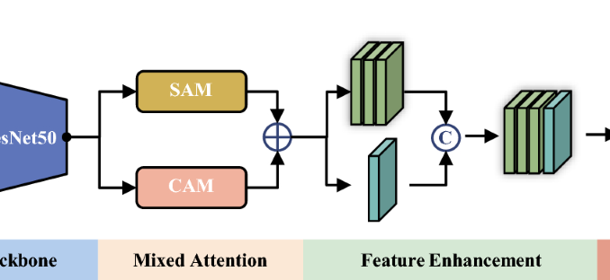
FOUR KEY STAGES CONT’D
Deep Learning & Sequence Models (2015-2017)
From 2015 to 2017, deep learning innovations like Recurrent Neural Networks (RNNs), Long Short-Term Memory (LSTMs), sequence-to-sequence models, and attention mechanisms greatly improved handling of long text dependencies, enabling better translation, summarization, and interpretability, and paving the way for the transformer era in Natural Language Processing (NLP)

Slide 12
Example
Deep Learning & Sequence Models (2015-2017)
In 2017, advances like LSTMs, sequence-to-sequence models and attention mechanisms enabled AI meeting assistants to produce concise, accurate summaries of hour-long meetings, preserving key details, focusing on important points, and outperforming earlier RNN-based approaches.

Slide 13

FOUR KEY STAGES CONT’D
Transformer Era (2018–Present)
A decisive turning point arrived in 2017 with the publication of “Attention Is All You Need” by Vaswani et al. (2017), introducing the transformer architecture.

Slide 14
Example
Transformer Era (2018–Present)
Transformers like BERT, GPT-4 and LegalBERT enable law firms to analyze lengthy legal documents in seconds, generating summaries, extracting key clauses, and identifying risks cutting review time, improving accuracy and freeing staff for higher-value tasks.

Slide 15

REVOLUTIONISING DATA CURATION AND MANAGEMENT THROUGH EMERGING LM ABILITIES

Slide 16
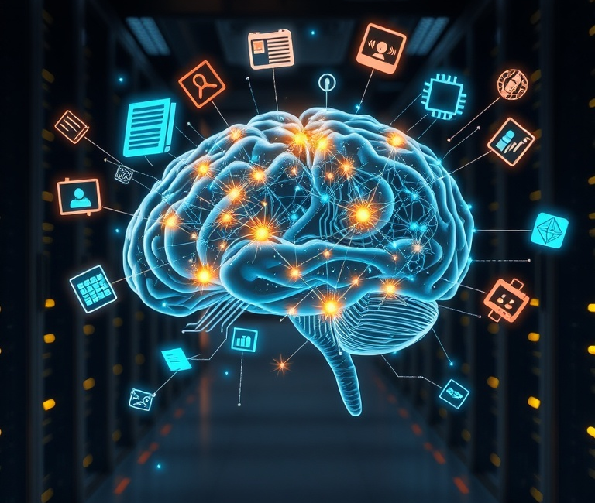
EMERGING LM ABILITIES
AUTOMATED METADATA GENERATION
Leveraging advanced algorithms, LMs automate metadata generation to speed up tagging and classification. This innovation minimizes manual effort while improving accuracy and consistency in data curation. Example A model like RoBERTa tags research papers with keywords (e.g., “machine learning”, “neural networks”) for a university’s digital library, improving discoverability
SEMANTIC SEARCH AND DISCOVERY
By utilizing language models, semantic search feature retrieves information based on meaning. This allows users to find relevant content in any language, enhancing data accessibility and usability. For instance, A legal firm uses a Transformer-based model to retrieve case law documents relevant to “breach of contract” queries, even if exact phrases are absent.

Slide 17
Emerging LM Abilities Cont’d
DATA CLEANING
LMs detect anomalies and standardize formats. For instance, GPT-4 standardizes inconsistent date formats (e.g., “12/01/23” vs. “January 12, 2023”) in medical records and extracts patient data into JSON for database integration
AUTOMATED SUMMARIZATION
LMs automate sensitive data redaction and compliance checks.
Example: A bank uses an LM to redact personally identifiable information (PII) like social security numbers from customer emails, ensuring GDPR compliance.
DATA GOVERNANCE AND COMPLIANCE
LMs create concise summaries of large datasets. GPT-3 summarizes 50-page quarterly reports for a financial analyst, highlighting key metrics like revenue growth and operational risks. For example, at the Ghana Statistical Service (GSS), an LM could automatically summarise extensive census reports or quarterly economic surveys into short briefs highlighting key demographic trends, shifts in employment patterns or changes in inflation rates.
NATURAL LANGUAGE QUERYING
PREDICTIVE & GENERATIVE ANALYTICS
LMs enables non-technical users to interact with databases. A retail company’s chatbot, powered by a conversational LM, answers “Show me all late shipments in Q2 2025”, querying a logistics database in real-time.
LMs forecast trends & generate synthetic data.
A healthcare provider uses GPT-4 to generate synthetic patient histories for AI model training, avoiding privacy violations under HIPAA

Slide 18
FUTURE POTENTIAL AND ETHICAL CONSIDERATION OF LMs
INTEGRATION POTENTIAL
KEY RISKS
ETHICAL SAFEGUARDS
Combining LMs with knowledge graphs, semantic web tools, and real-time data sources can improve accuracy, interconnected insights, and timeliness of curated datasets vital for fast-changing fields like finance, healthcare, and climate monitoring.
Bias: Risk of reinforcing gender,
racial or cultural stereotypes
Interpretability: Increasing difficulty
in explaining model reasoning.
Privacy: Potential exposure or
misuse of sensitive data.
Transparent model design, robust data governance, clear consent and anonymization policies, and multidisciplinary oversight to ensure socially responsible deployment.

Slide 19
LIMITATIONS OF LMs
ETHICAL SAFEGUARDS
SHOW LIMITED GENERAL REASONING ABILITIES
For instance, Apple’s recent study, The Illusion of Thinking, explores how advanced models that generate detailed reasoning steps (like Claude 3.7 Thinking or DeepSeek-R1) fail surprisingly.
No matter how advanced the AI model is, its reasoning abilities lag behind big time. This includes common-sense reasoning, logical reasoning and ethical reasoning.
CAN PRODUCE HALLUCINATIONS AND FACTUAL ERRORS
MAY GENERATE BIASED OR OFFENSIVE CONTENT
Example: an AI summary tool misinformed some users of the BBC Sport app that tennis star Rafael Nadal had come out as gay and that he’s Brazilian (neither of these is true).
LACK TRANSPARENCY IN EXPLAINING DECISIONS
Due to the presence of biases in training data, LMs can negatively impact individuals and groups by reinforcing existing stereotypes and creating derogatory representations, among other harmful consequences.
The "Chain-of-Thought" (CoT) prompting technique

Slide 20
IMPACT OF LMs ON DATA CURATION AND MANAGEMENT
Language Models (LMs) have brought significant transformations to data curation and management by addressing long-standing challenges in the field
Challenge in Data Curation | LM-Driven Solution | Impact
Large volumes of unstructured data | Automated classification & tagging | Faster organization & retrieval
Inconsistent metadata standards | Context-aware metadata harmonization | Improved interoperability
Manual, slow data cleaning | Intelligent anomaly detection | Higher accuracy & efficiency
Limited access for non-technical staff | Natural language database interfaces | Broader participation in data usage
Difficulty spotting trends | Predictive analytics & pattern detection | More informed decision-making

Slide 21

Conclusion & Future
LMs have evolved significantly, impacting data curation strategies.
They automate metadata creation and improve data quality significantly.
The future includes embracing new technologies for better data insights.
Challenges remain, such as biases in language models.
Continued innovation is essential for data ecosystem enhancement.

Slide 22
References
FinTech Weekly. (2025, May 12). Klarna reverses course on AI customer support, resumes
human hiring. FinTech Magazine Articles
Goyal, N., & Ferrara, E. (2023). Large language models and their applications in information
retrieval. Journal of Data and Information Science, 8(2), 1–18.
https://doi.org/10.2478/jdis-2023-0010
Liang, P. (2022). Advances in natural language interfaces to databases. Communications of
the ACM, 65(5), 98–107. https://doi.org/10.1145/3511094
Tzitzikas, Y., Marketakis, Y., & Minadakis, N. (2021). Semantic search and metadata
enrichment with AI. International Journal on Digital Libraries, 22(1), 1–18.
https://doi.org/10.1007/s00799-020-00302-y
Vaswani, A., et al. (2017). Attention is all you need. In Advances in Neural Information
Processing Systems (Vol. 30, pp. 5998–6008). Curran Associates, Inc.
https://arxiv.org/abs/1706.03762

Slide 23

Thank You

